Slide 1

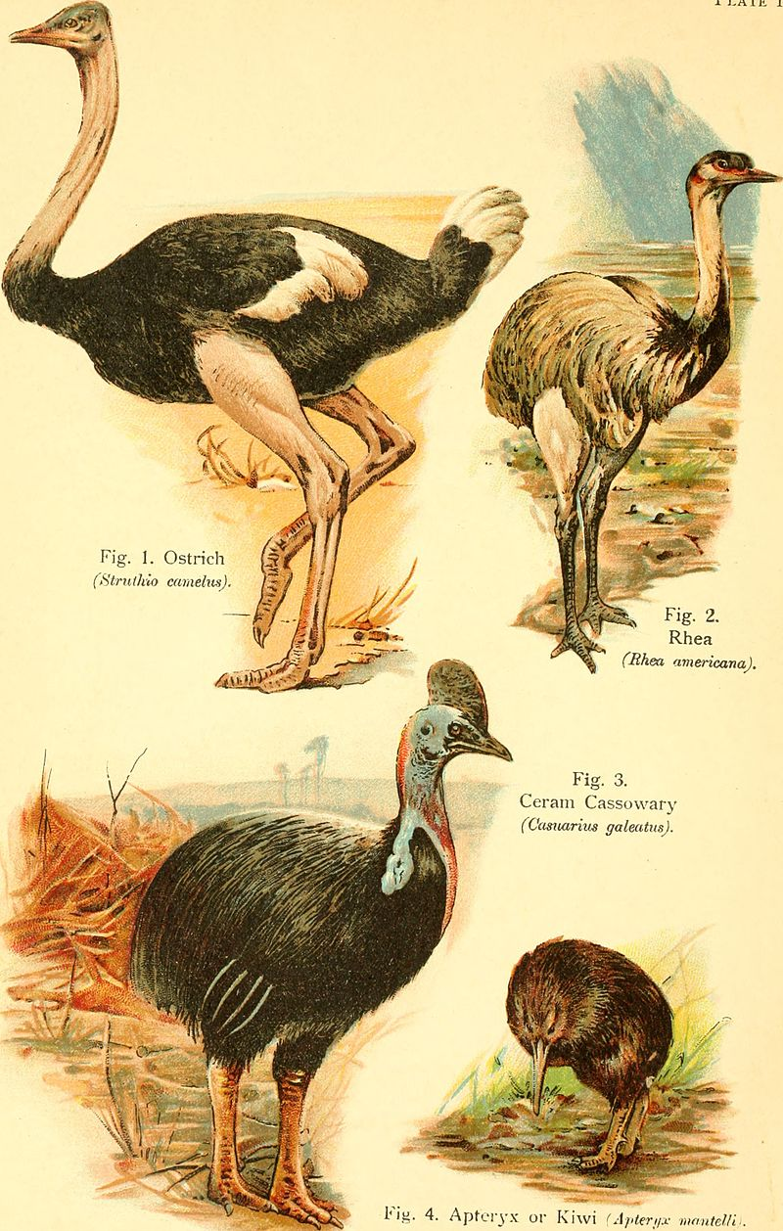

Exploring Evolution: Unveiling the History of Flightless Birds Through Phylogenetic Trees.
Level 1 NCEA Genomics workshop for CB 1.3 Wellington
Notes:
This workshop will use genetics to build phylogenetic trees and understand the evolution of this particular group of birds, the ratites. This workshop is split into two parts; one more hands-on activity, and another activity which is entirely online.
Image:
By Pycraft, William Playne - https://www.flickr.com/photos/internetarchivebookimages/20209642889/Source book page: https://archive.org/stream/bookofbirds00pycr/#page/n7/mode/1up, No restrictions,
https://commons.wikimedia.org/w/index.php?curid=42222143
This image was originally posted to Flickr by Internet Archive Book Images at https://flickr.com/photos/126377022@N07/20209642889. It was reviewed on 10 August 2015 by FlickreviewR and was confirmed to be licensed under the terms of the No known copyright restrictions.

Slide 2

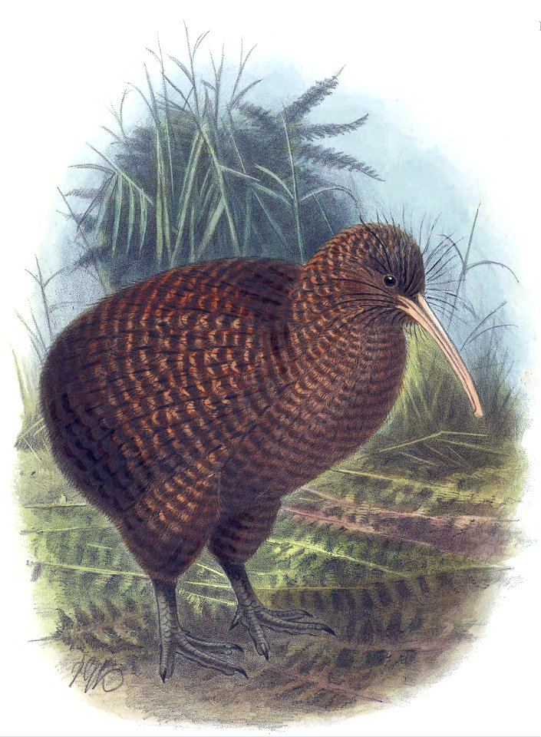
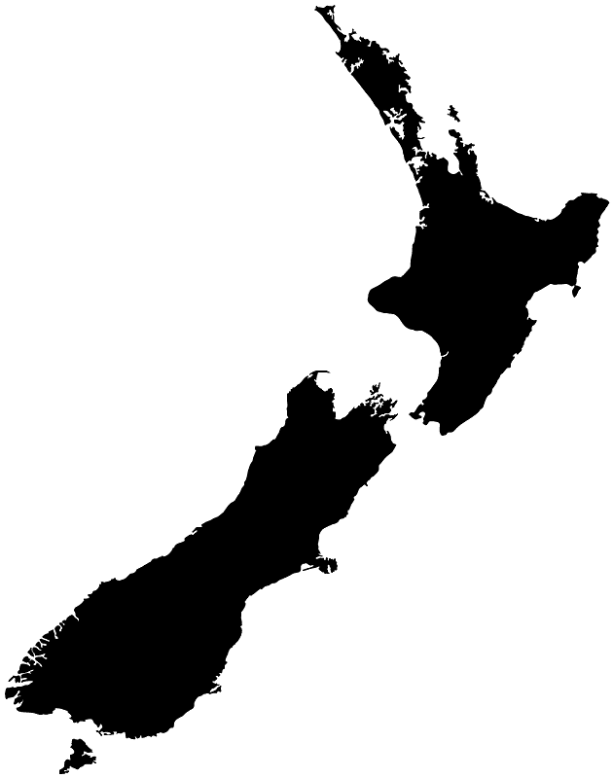
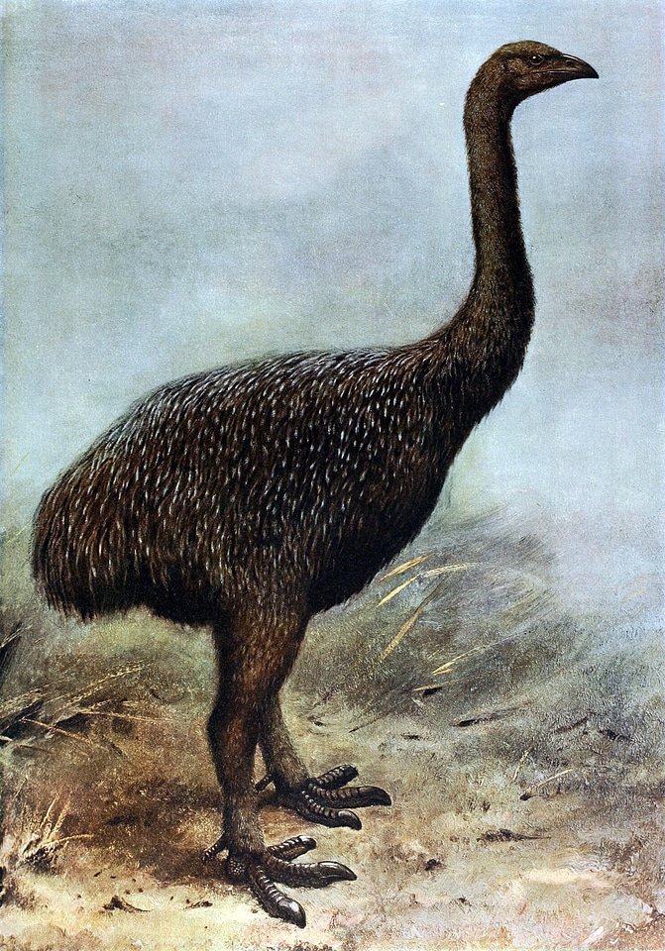
How do we determine the evolutionary relationships between different species?
Is proximity or physical similarity enough to suggest a close relationship, or is there more to uncover?
DNA provides the evidence we need to understand evolutionary relationships by tracking changes through time.
Notes:
Before we dive into today’s workshop, let's consider some guiding questions:
How do we determine the evolutionary relationships between different species?
Is proximity or physical similarity enough to suggest a close relationship, or is there more to uncover?
We often think that animals living close together or sharing similar features are closely related. Take the kiwi in New Zealand and the extinct Moa—both are flightless birds from Aotearoa New Zealand. Do they share a recent common ancestor, or did they evolve flightlessness independently due to similar environmental pressures?
Physical appearance and geography might hint at connections, but DNA provides the concrete evidence we need. It allows us to trace the 'family tree' of life, revealing deep relationships that aren't always visible on the surface.
Today, we'll explore how DNA helps us uncover these hidden connections, linking even distant species through a common evolutionary past.
Published by: CreazillaAuthor: George Edward LodgeSource: goodfreephotos.com/Licence:Public Domain. Free for editorial, educational, commercial, and/or personal projects. No attribution required. More info.
The Extinct Giant Moa - Megalapteryx didinus
Apteryx haastii Keulemans
Published by: CreazillaAuthor: Creator:John Gerrard KeulemansSource: commons.wikimedia.orgLicence:Public Domain. Free for editorial, educational, commercial, and/or personal projects. No attribution required. More info.

Slide 3


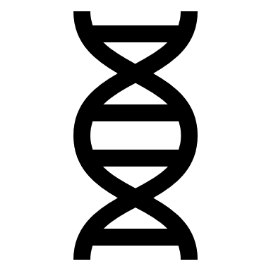






What is evolution? A change in the heritable traits across generations (time).
Changes are introduced, for example, by mutation (errors in the genetic code) – and mutations can accumulate over time.
Notes:
Scientists rely on genetic information to trace evolutionary relationships because DNA acts as a historical archive of life's evolution.
Evolution: Any change in the heritable traits within a population across generations.
This change can be introduced by mutation. When DNA is being replicated, during reproduction, errors can occur in the code- DNA mutation. small changes in the DNA sequence
These mutations can create variation, such as here- we have a different coloured bird. There has been a change in trait. If we look at the birds genetics, and the nucleotide sequence, we can see that whilst most of the sequence is conserved, indicating shared ancestry. The difference at the seventh nucleotide represents a mutation.
Bird photos:
Published by: CreazillaAuthor: gahag.netSource: gahag.netLicence:Public Domain. Free for editorial, educational, commercial, and/or personal projects. No attribution required. More info.

Slide 4

What is evolution? A change in the heritable traits across generations (time).
Changes are introduced, for example, by mutation (errors in the genetic code) – and mutations can accumulate over time.
Notes:
The difference at the fourth nucleotide represents a mutation. This is a point mutation that may be responsible for the birds change of trait.
Published by: CreazillaAuthor: gahag.netSource: gahag.netLicence:Public Domain. Free for editorial, educational, commercial, and/or personal projects. No attribution required. More info.

Slide 5
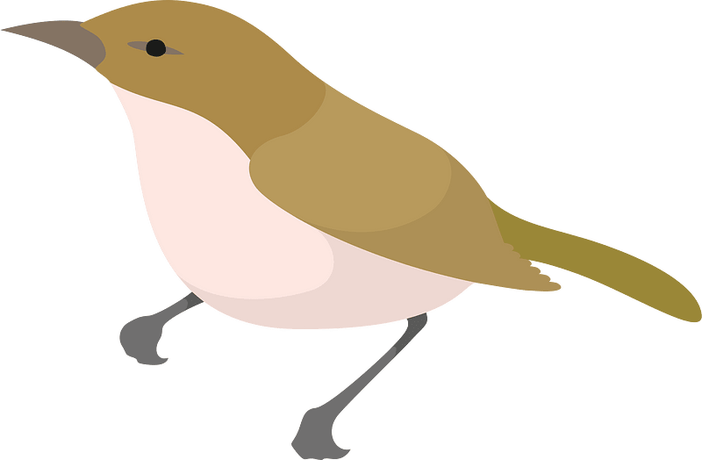

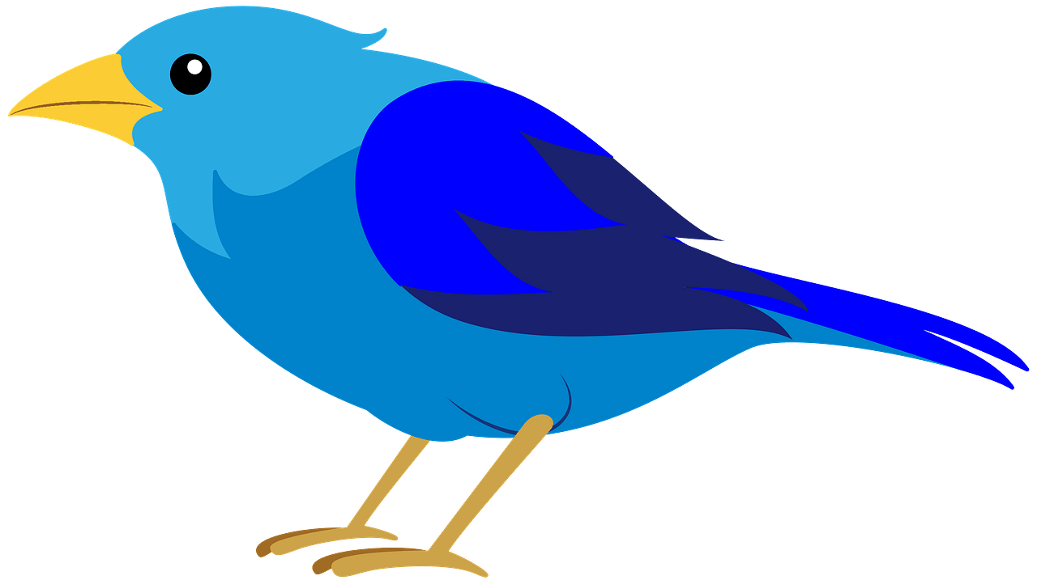

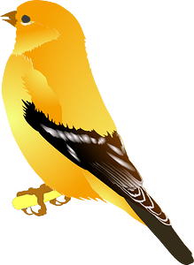

What is speciation? The formation of new and distinct species in the course of evolution.
1
2
3
Over time, there has been an accumulation of many mutations- leading to the variation we see.
Generations (time)
Present
Notes:
If we now begin to look at the lineage of our mutated bird, at each node, there has been a mutation causing a different lineage; the mutations which are advantageous are pssed onto offspring, again and again, and accumulate over time.
so instead of just different colours, more mutations = more variable traits. With enough mutations, we can get speciation; here, the code still has conserved regions, but there is a much larger number of differences.
In reality, many mutations happen, especially during speciation-
Image:
https://creazilla.com/media/clipart/7799983/bird
https://creazilla.com/media/clipart/11384/japanese-bush-warbler-bird
https://creazilla.com/media/clipart/67500/bird
https://creazilla.com/media/clipart/1990268/goldfinch
Published by: Creazilla
Licence: Public Domain. Free for editorial, educational, commercial, and/or personal projects. No attribution required. More info.

Slide 6
Quick recap:
What is evolution? A change in the heritable traits across generations (time).
Changes are introduced, for example, by mutation (errors in the genetic code) – and mutations can accumulate over time.
Knowing this, the greater the genetic difference between individuals, the more far back the connection between them.

Slide 7
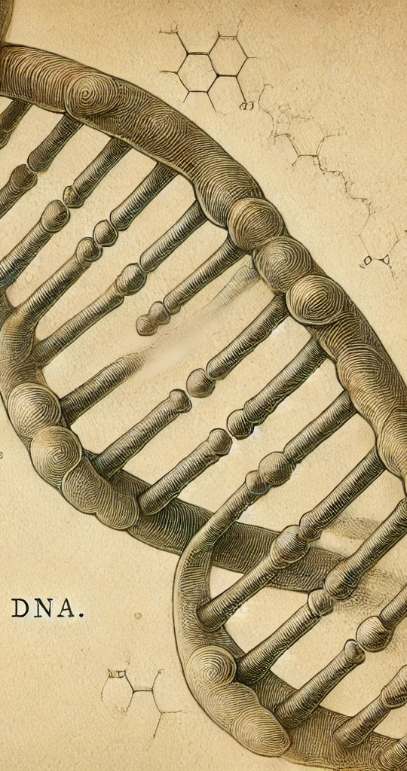
The workshop:
In todays workshop example, we only have the DNA sequences.
We will apply the logic that more genetic differences suggest more time for mutations to accumulate, indicating a more distant common ancestry. In this way, we can trace backwards to reconstruct the evolutionary history.
We are looking at ratites – a group of flightless birds (note: the tinamou is capable of flying short distances, but prefers to run/walk!)
Ostrich
Rhea
Kiwi (Great Spotted, North Island Brown, and Okarito)
Moa
Elephant Bird
Brushland Tinamou
Notes:
Ostrich
Rhea
Kiwi (Great Spotted, North Island Brown, and Okarito)
Moa
Elephant Bird
Brushland Tinamou
Image:
ChatGPT

Slide 8
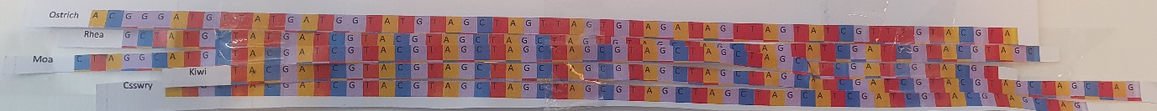
Part 1 – Manual DNA sequence alignment.
Aims:
To manually align simplified nucleotide sequences in order to understand how sequence alignments work and how differences in DNA can be used to build a basic phylogenetic tree.
You have been provided with DNA sequence strips for 5 ratite species.
Each nucleotide (A, T, C, G) has been colour-coded for ease.
Aligning the strips will look something like this:
121bp aligned (‘matching’) region
Start of the alignment
End of the alignment
Notes:
The start of the alignment can differ e.g due to sequence evolution of the quality of the DNA/data we have- degradation or instruments.

Slide 9
Step 2: Count the Number of Differences and Fill in the Matrix of Differences
Pairwise Comparison:
For each pair of species, count the number of positions where the nucleotides differ.
Record the Differences:
Use the provided matrix on the next page to record the number of differences between each pair of species.
A
 | A | B | C
A | 0
B | 3 | 0
C |  |  | 0
 | A | B | C
A | 0
B |  | 0
C |  |  | 0
B
C

Slide 10
Step 2: Count the Number of Differences and Fill in the Matrix of Differences
Pairwise Comparison:
For each pair of species, count the number of positions where the nucleotides differ.
Record the Differences:
Use the provided matrix on the next page to record the number of differences between each pair of species.
A
 | A | B | C
A | 0
B | 3 | 0
C | 4 |  | 0
B
C

Slide 11
Step 2: Count the Number of Differences and Fill in the Matrix of Differences
Pairwise Comparison:
For each pair of species, count the number of positions where the nucleotides differ.
Record the Differences:
Use the provided matrix on the next page to record the number of differences between each pair of species.
A
 | A | B | C
A | 0
B | 3 | 0
C | 4 | 1 | 0
B
C
Species with fewer differences are more likely to be closely related and vice versa (B and C are closely related; A and C are more distantly related)

Slide 12
Step 3: Building a phylogenetic tree
Phylogeny; the history of the evolution of a species or group.
3a. Start with the species pair that has the least differences
Starting with B and C:
C
 | A | B | C
A | 0
B | 3 | 0
C | 4 | 1 | 0
B
Notes:
What does phylogeny mean?

Slide 13
Step 3: Building a phylogenetic tree
Phylogeny; the history of the evolution of a species or group.
3a. Start with the species pair that has the least differences
Starting with B and C:
Now working from least -> most, adding new species
C
 | A | B | C
A | 0
B | 3 | 0
C | 4 | 1 | 0
B
A
Notes:
What does phylogeny mean?

Slide 14
Step 3: Building a phylogenetic tree
Phylogeny; the history of the evolution of a species or group.
3a. Start with the species pair that has the least differences
Starting with B and C:
Now working from least -> most, adding new species
C
 | A | B | C
A | 0
B | 3 | 0
C | 4 | 1 | 0
B
A
Notes:
What does phylogeny mean?
Cladograms illustrate hypothetical relationships and shared traits without indicating evolutionary time, while phylogenetic trees provide detailed information as they can depict the rate of evolution and time scale based on genetic data.

Slide 15
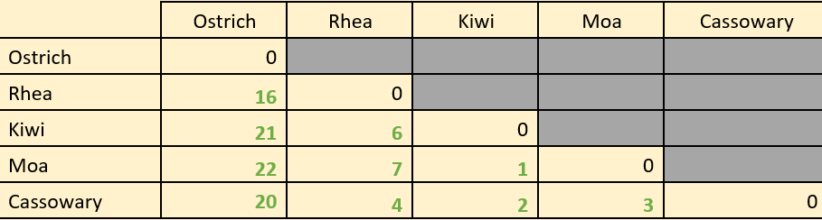
In the workshop, you have more species than just 3.
The logic is the same; start with the species pair with the least differences, then continue from least -> most differences until all species are present.
(In this case, we start with the Kiwi and Moa pairing)
Notes:
(Tree example)

Slide 16
In the workshop, you have more species than just 3.
The logic is the same; start with the species pair with the least differences, then continue from least -> most differences until all species are present.
(In this case, we start with the Kiwi and Moa pairing)
Ostrich
Rhea
Cassowary
Kiwi
Moa
Notes:
(Tree example)

Slide 17
Workshop part 1 review:
Start by aligning the nucleotide strips
2. Create a matrix and count the differences between the species.
3. Using the matrix, create a phylogenetic tree (starting with the pair with the least differences)
121bp aligned (‘matching’) region
Start of the alignment
End of the alignment
 | Ostrich | Rhea | Kiwi | Moa | Cassowary
Ostrich | 0
Rhea |  | 0
Kiwi |  |  | 0
Moa |  |  |  | 0
Cassowary |  |  |  |  | 0
Notes:
PAUSE HERE.

Slide 18

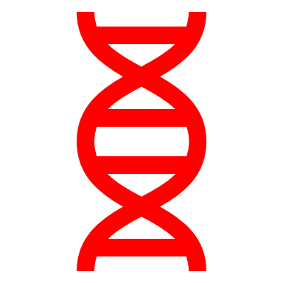
This manual alignment process mirrors the approach used by computer algorithms, but it is impractical for real-world genetic data.
In the manual alignment workshop example, we’re using a ~121bp region.
In reality, sequences can be much longer. If we use the entire sequence of an organisms DNA, this can be hundreds of thousands to billions of base pairs.
VS
Whole genome (thousands-billions! Of bases
Small segment (100 bases)
Comparing and aligning these longer sequences by hand would be impractical, if not impossible.
That’s why we use computer tools and algorithms to help us.
Notes:
Part 2; welcome back
The above manual alignment process mirrors the approach used by a popular computational algorithm known as Neighbor-Joining (NJ). This algorithm is widely used in bioinformatics for constructing phylogenetic trees because it provides a fast and efficient method for inferring evolutionary relationships between species. While manual alignment of short sequences helps illustrate the principles behind phylogenetic tree construction, in reality, the sequences scientists work with in research are often thousands to millions of nucleotides long. Comparing and aligning these longer sequences by hand would be impractical, if not impossible.
Longer sequences -> higher resolution, as mentioned by Imogen.
Also, how much can we trust this? Short sequenc,e might not capture all of the variation so there could be misinformed relationships. In science, we work towards greater and greater resolutions of truth- in theory, the more agreeing information we have across fields, then the more confidence we can have.

Slide 19
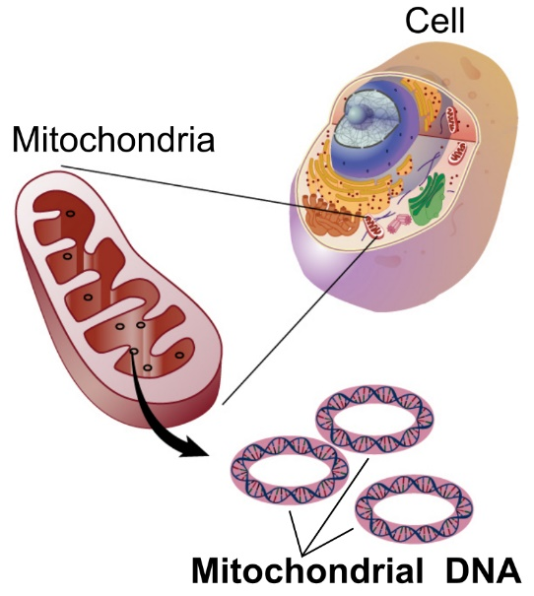
Part 2: Computer-Based Sequence Alignment and Phylogeny Construction
For this exercise, we will use the Cytochrome B gene, which is part of the mitochondrial genome (>1,000 nucleotides).
Ratites (flightless birds) are a relatively young evolutionary group, and Cytochrome B evolves at a rate that is particularly useful for resolving relationships between species that diverged more recently.
We will use an online tool, Clustal Omega, to analyse the sequences.
Notes:
Image:
https://commons.wikimedia.org/wiki/File:Mitochondrial_DNA_lg.jpg
Source National Institutes of Health. National Human Genome Research Institute. “Talking Glossary of Genetic Terms”.
Public domain

Slide 20
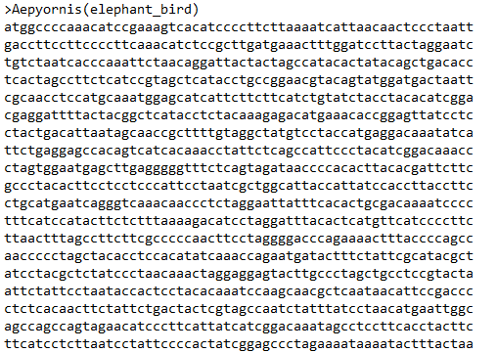
The fasta file
The sequences are contained in a ‘fasta file’. FASTA is a text-based format for storing and representing nucleotide sequences in bioinformatics.
Header/name
Nucleotide sequence
Notes:
The

Slide 21
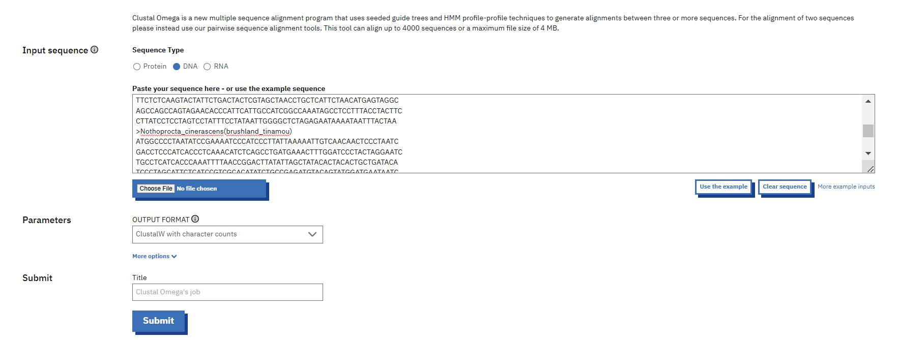
Using clustal omega
Select ‘DNA’
Notes:
Ostrich
Rhea
Kiwi (Great Spotted, North Island Brown, and Okarito)
Moa
Elephant Bird
Brushland Tinamou

Slide 22
Using clustal omega
Copy and paste the .fasta sequences into here
Notes:
Ostrich
Rhea
Kiwi (Great Spotted, North Island Brown, and Okarito)
Moa
Elephant Bird
Brushland Tinamou

Slide 23
Using clustal omega
Select ‘ClustalW with character counts’
Notes:
Ostrich
Rhea
Kiwi (Great Spotted, North Island Brown, and Okarito)
Moa
Elephant Bird
Brushland Tinamou

Slide 24
Using clustal omega
And submit!
Notes:
Ostrich
Rhea
Kiwi (Great Spotted, North Island Brown, and Okarito)
Moa
Elephant Bird
Brushland Tinamou

Slide 25
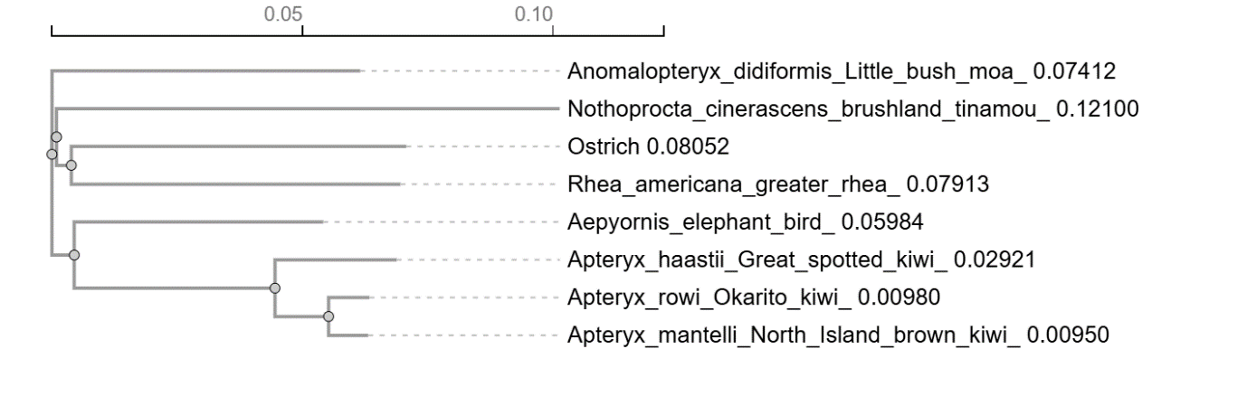
The tree:

Slide 26
The tree:
Branches: indicates the genetic distance between species; longer branches suggest more genetic differences and earlier divergence.

Slide 27
The tree:
Nodes: where two branches meet and represents a common ancestor of those species.

Slide 28
The tree:
Scale bar: The scale bar (e.g., 0.10) represents genetic distance. It shows the number of nucleotide differences per sequence length. For example, a distance of 0.1 means that, on average, 10% of nucleotides differ between the species.

Slide 29
The tree:
Interestingly, the kiwis group closer to the elephant bird than to the moa.
How can this be?

Slide 30
Gondwana Breakup Over Time
Phylogeny of modern-day ratites
Understanding the Evolution of Ratites through Continental Drift:
Millions of years ago, these birds' ancestors lived together on the supercontinent Gondwana.
When Gondwana broke apart, bird populations were carried to different continents.
These isolated populations adapted to their environments, evolving into unique species.
Example: Kiwis and elephant birds share a common ancestor from Gondwana. When Gondwana split, this common ancestor adapted to its environment.
[IMAGE REDACTED – SEE NOTES]
The map on the left shows how Gondwana split over time, and the tree on the right demonstrates how this led to the evolution of different species of flightless birds.
Notes:
Image redacted due to unknown copyright permissions.
Refer to Figure 3 of the following article:
Ancient DNA reveals elephant birds and kiwi are sister taxa and clarifies ratite bird evolution Kieren J. Mitchell,1 Bastien Llamas,1 Julien Soubrier,1 Nicolas J. Rawlence,1 * Trevor H. Worthy,2 Jamie Wood,3 Michael S. Y. Lee,1,4 Alan Cooper1

Slide 31
Thank you for listening!
Any questions?
Carla.finn@vuw.ac.nz
Thanks and acknowledgement to Wilda Laux and Peter Ritchie
Notes:
Image 1
By Pycraft, William Playne - https://www.flickr.com/photos/internetarchivebookimages/20209642889/Source book page: https://archive.org/stream/bookofbirds00pycr/#page/n7/mode/1up, No restrictions,
https://commons.wikimedia.org/w/index.php?curid=42222143
This image was originally posted to Flickr by Internet Archive Book Images at https://flickr.com/photos/126377022@N07/20209642889. It was reviewed on 10 August 2015 by FlickreviewR and was confirmed to be licensed under the terms of the No known copyright restrictions.
Image 2:
Generated by ChatGPT

